Slide 1
UNDERSTANDING AGENTIC A.I.
Dushyant Prabhakar (DP12952), Ganesh Sriramulu (GS12388)

Slide 2
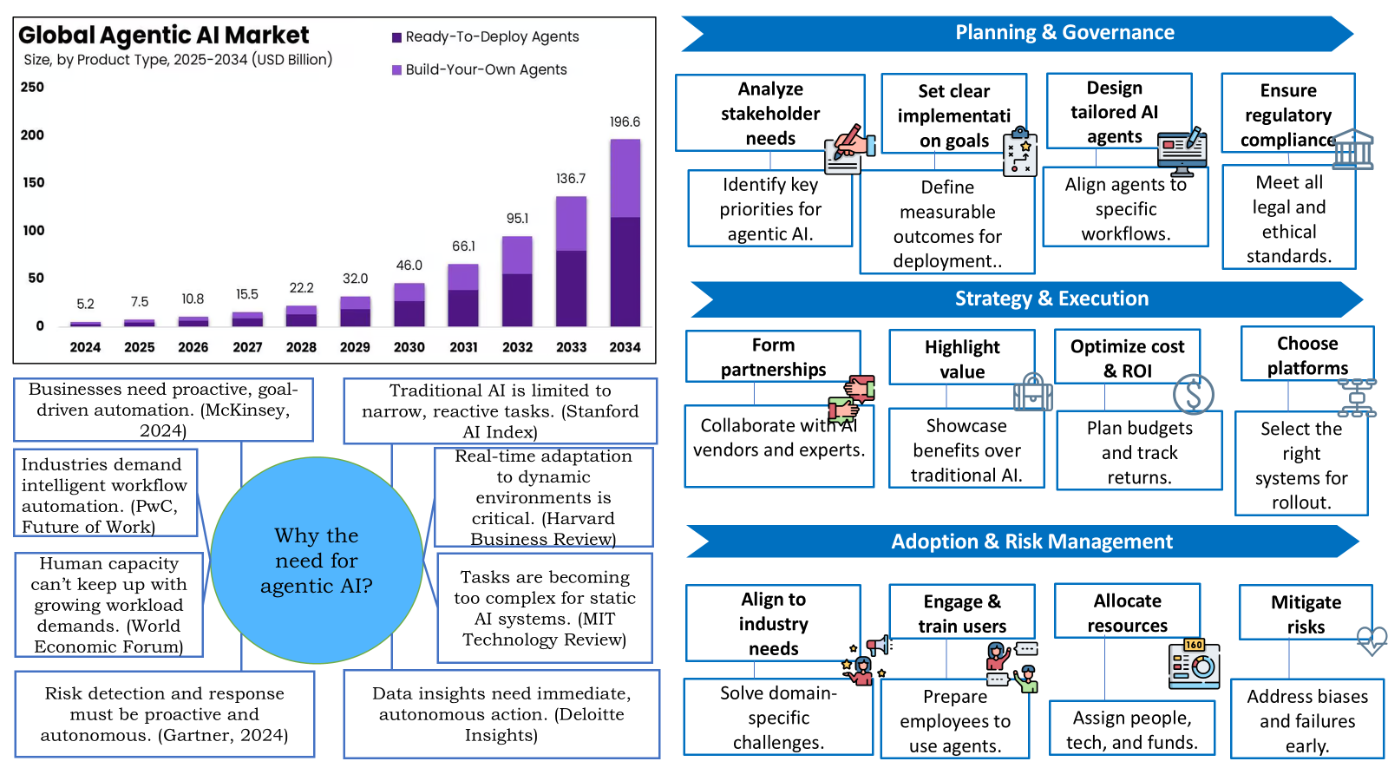

Slide 3
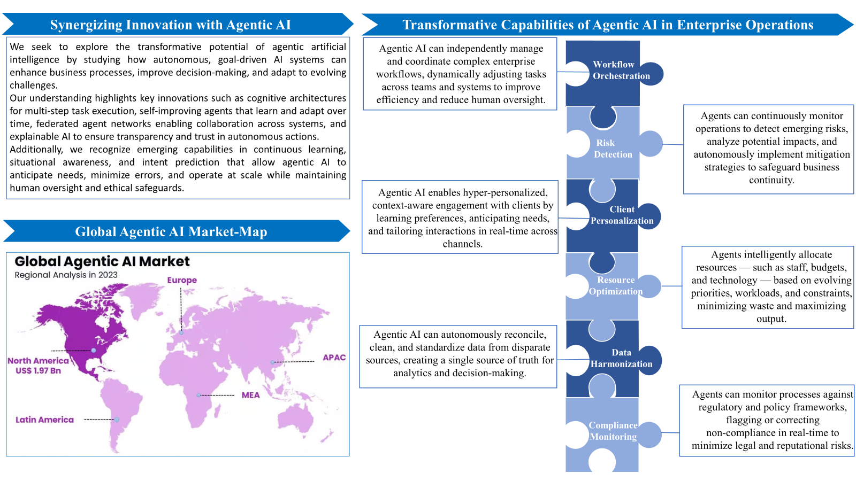

Slide 4
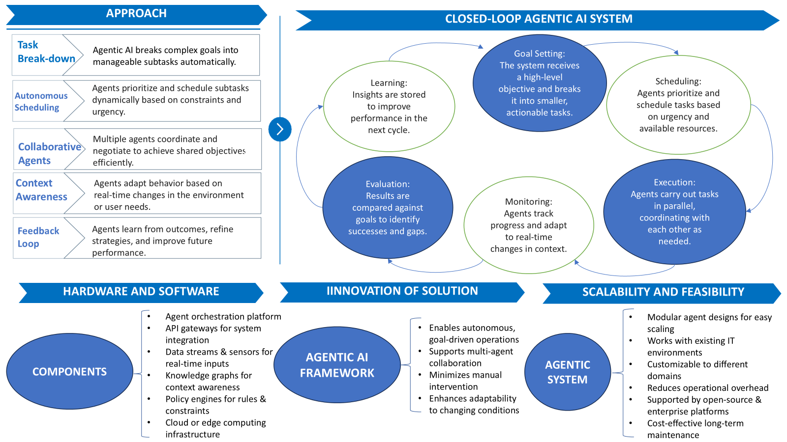

Slide 5
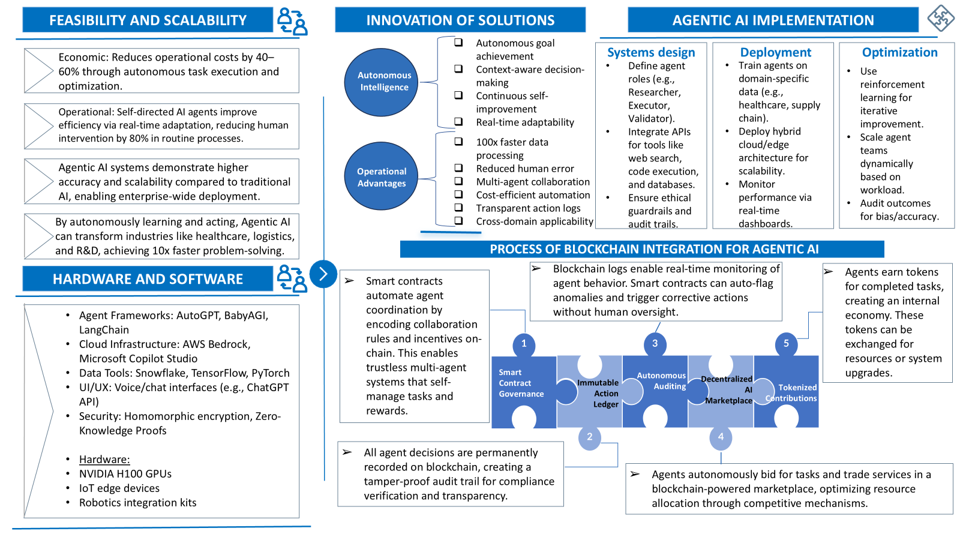

Slide 6
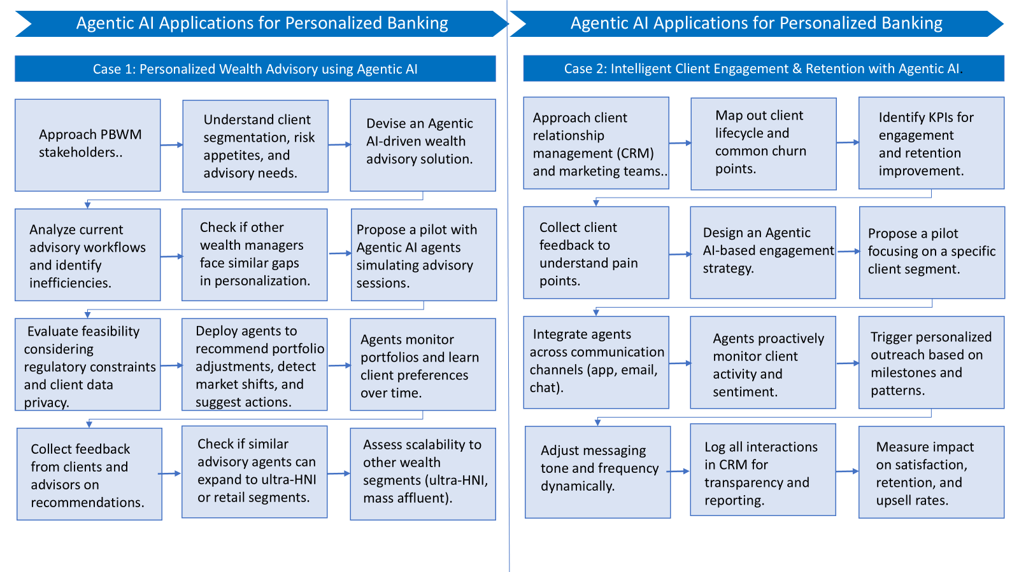

Slide 7
Thank you…!!!

